Slide 1
Data Center Infrastructure CT109-3-2&Version 2
Fire Suppression Systems

Slide 2
Topic & Structure of The Discussion
Fire Suppression Systems & its types

Slide 3
Learning Outcomes
At the end of this topic, YOU should be able to:
Understand Fire Suppression System Types

Slide 4
Key Terms You Must Be Able To Use
If you have mastered this topic, you should be able to use the following terms correctly in your assignments and exams:
Sprinkler
CO2
Inergen

Slide 5
What is Fire Suppression Systems?
Fire suppression systems are designed to extinguish fires, or, at the least, prevent them from spreading.
They work by dispersing water or chemicals at the site of a potential fire when heat sensors detect signs of an emergent fire, and some systems can be manually activated.

Slide 6
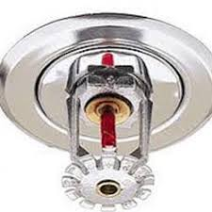
Fire Suppression System Types
Water Sprinkler Systems
It consists of distribution piping system that is permanently attached to building structures, valve station and sprinkler heads that are firmly attached to the distribution pipes in the protected area.
Water flows out from the sprinkler heads and sprays the area where fire is present.

Slide 7
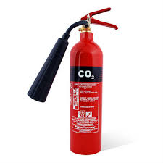
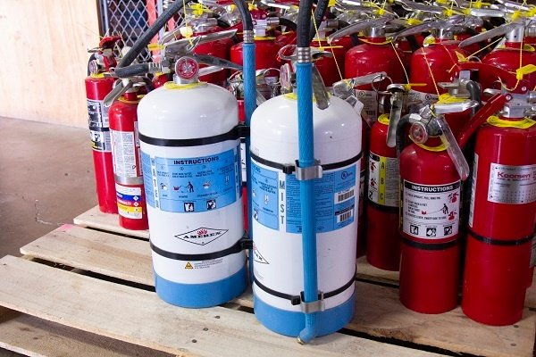
Fire Suppression System Types
CO₂ Systems – Provide a heavy blanket of gas that reduces the oxygen level to a point where combustion cannot occur. Because it’s unsafe for people, CO₂ is only recommended for localized applications or areas generally inaccessible by employees or customers.
Water Mist Systems – Improve upon the traditional water sprinkler system by producing ultra-fine water droplets and using 50 to 90 percent less water than a fire sprinkler, resulting in little to no collateral damage. Water mist systems may be connected to a building’s water supply for continuous fire-fighting capability, or in remote locations, may be connected to a tank or reservoir.

Slide 8
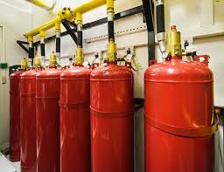
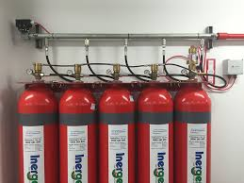
Fire Suppression System Types
Chemical Clean Agents – Include ECARO-25® (HFC-125), FM-200 (HFC-227ea), 3MTM NovecTM 1230 Fire Protection Fluid and others, all of which offer fast-acting, and most importantly, people-safe fire-suppressing solutions.
Clean agents protect irreplaceable assets, such as computers, servers, electronics, artwork, archives and more, as they produce none of the damage often associated with traditional water sprinkler systems.
Inert Gases – Include nitrogen, argon and CO₂, or a combination of two or more, and reduce oxygen levels to a point where combustion cannot be sustained. These gaseous agents are safe for both people and the environment.

Slide 9
Which factors are most important to your organization?
Cost Effectiveness
With the recent introduction of low-pressure water mist systems, water mist has become a cost-effective method of fire suppression.
Of the chemical agent fire suppression systems, ECARO-25 is the most cost-effective solution from an agent cost-per-pound basis.
Design Flexibility
Inert gas systems provide the most flexible design options

Slide 10
Which factors are most important to your organization?
Environmental Friendliness
Water-based systems and inert gas systems are the greenest options available, since water and inert gas are naturally occurring substances that we extract from the environment and harness for use in fire suppression.
Among the chemical agents, FK-5-1-12 is the most environmentally benign with a global warming potential (GWP) value of one.

Slide 11
Which factors are most important to your organization?
Downtime/Cleanup
Traditional water sprinklers can produce as much damage to a building or its critical assets as a fire itself.
Conversely, a chemical clean agent or inert gas would suppress the fire quickly with very little business lost as a result of downtime.

Slide 12
Which fire suppression systems are most effective for my application?
Commercial Applications – Include hospitality, healthcare, schools, libraries and office buildings; places where people live, work and do business. For example, a health care facility may use water mist to protect rooms, common areas and backup generators, and a chemical agent like HFC-125 or HFC-227ea for server rooms, and electronic medical equipment like MRIs.
Industrial Applications – Include factories and machine shops; where things are made. Water mist and CO₂ are most commonly used because of their cost effectiveness and the types of hazards most commonly found in these environments.
Irreplaceable Asset Applications – Include data centers, telecommunications facilities, museums and historical sites; where critical assets are contained. For the greatest protection and preservation of irreplaceable assets, such as server-backed user information or historical artifacts, gaseous agents (chemical or inert) are ideal.

Slide 13
Quick Review Questions
Which fire suppression systems are most effective for my
application?
Which factors are most important to your organization?
What are the different types of fire suppression systems?

Slide 14
Summary of Main Teaching Points
Discussed Fire Suppression Systems

Slide 15
Question and Answer Session
Q & A

Slide 16
What we will cover next
Electrical Distribution System

